Slide 1
UNIT - 4
SCADA

Slide 2
SCADA stands for “Supervisory Control and Data Acquisition”.
SCADA is a type of process control system architecture that uses computers, networked data communications and graphical Human Machine Interfaces (HMIs) to enable a high-level process supervisory management and control.

Slide 3
Functions of SCADA Systems
SCADA system is a collection of hardware and software components that allows the manufacturing units to perform specific functions.
To monitor and gather data in real-time
To interact with field devices and control stations via Human Machine Interface (HMI)
To record systems events into a log file
To control manufacturing process virtually
Information Storage and Reports

Slide 4
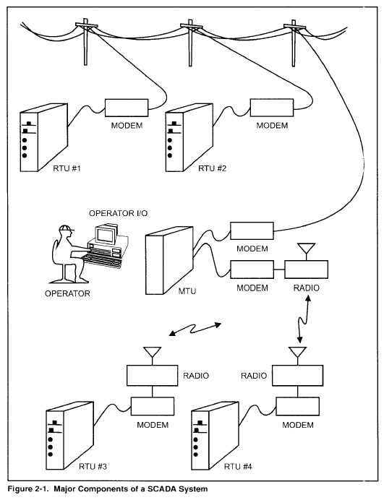
Components of a SCADA system
Master Terminal Unit (MTU)
Remote Terminal Unit (RTU)
Communication Network

Slide 5
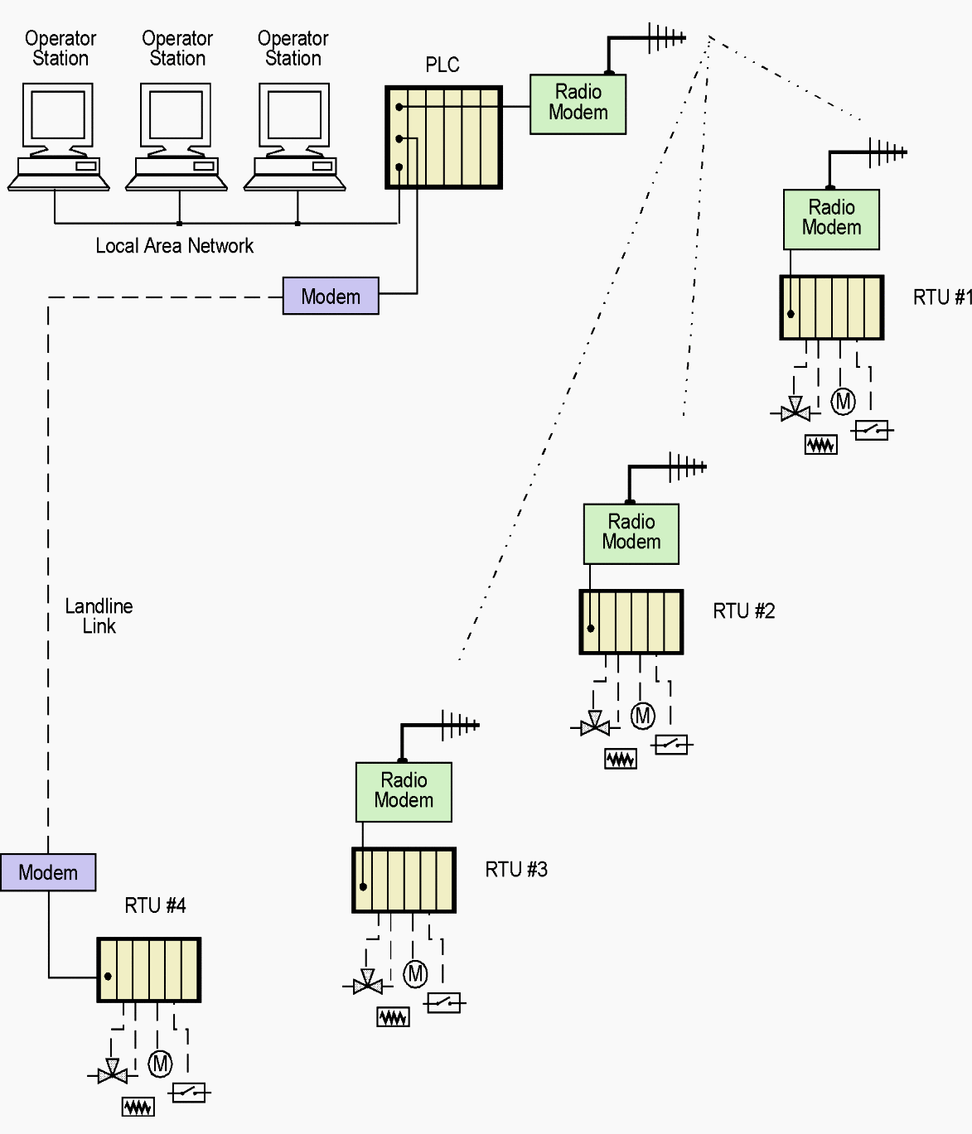
SCADA system

Slide 6
Master Terminal Unit (MTU)
MTU is the core of the SCADA system.
It comprises a computer, PLC and a network server that helps MTU to communicate with the RTUs.
MTU begins communication, collects and saves data, helps to interface with operators and to communicate data to other systems.

Slide 7
Remote Terminal Unit (RTU)
Remote Terminal Unit (RTU) is connected with sensors and actuators.
RTU is used to collect information from these sensors and further sends the data to MTU.
RTUs have the storage capacity facility. So, it stores the data and transmits the data when MTU sends the corresponding command.
Recently developed units are employed with systems, that utilize PLCs as RTUs. This helps for direct transfer and control of data without any signal from MTU.

Slide 8
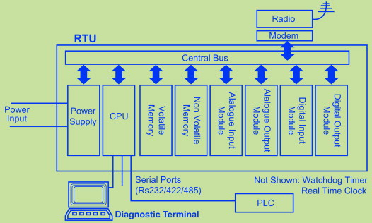
RTU hardware module

Slide 9
Control processor (or CPU)
This is generally microprocessor based (16 or 32 bit)
RAM is volatile memory that temporarily stores the files you are working on. ROM is non-volatile memory that permanently stores instructions for your computer.
Diagnostic LEDs provided on the control unit ease troubleshooting and diagnosis of problems (such as CPU failure/failure of I/O module etc).
The real-time clock is useful for accurate time stamping of events.
A watchdog timer is also required to provide a check that the RTU program is regularly executing.

Slide 10
Analog input modules
There are five main components making up an Analog input module. They are
the input multiplexer,
the input signal amplifier,
the sample and hold circuit,
the A/D converter and
the bus interface and board timing system.

Slide 11
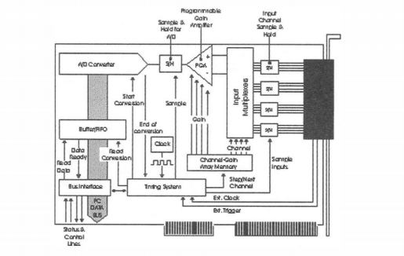
Typical analog input module

Slide 12
Analog output module
Typically the analog output module has the following features:
• 8 analogue outputs
• Resolution of 8 or 12 bits
• Conversion rate from 10 |i seconds to 30 milliseconds
• Outputs ranging from 4-20 mA/± 10 volts/0 to 10 volts

Slide 13
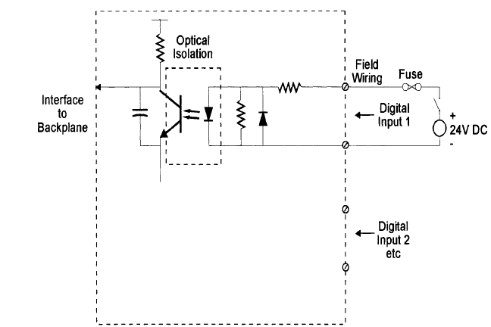
Digital input module
Typically the following would be expected of a digital input module:
• 16 digital inputs per module
• Associated LED indicator for each input to indicate current states
• Digital input voltages vary from 110/240 VAC and 12/24/48 VDC
• Optical isolation provided for each digital input

Slide 14
Digital output module
A digital output module drives an output voltage at each of the appropriate output channels with three approaches possible:
• Triac switching
• Relay switching
• TTL voltage outputs
Typical digital output modules consists of
• 8 digital outputs
• 240 V AC/24 V DC (0.5 amp to 2.0 amp) outputs
• Associated LED indicator for each output to indicate current status
• Optical isolation for each output

Slide 15

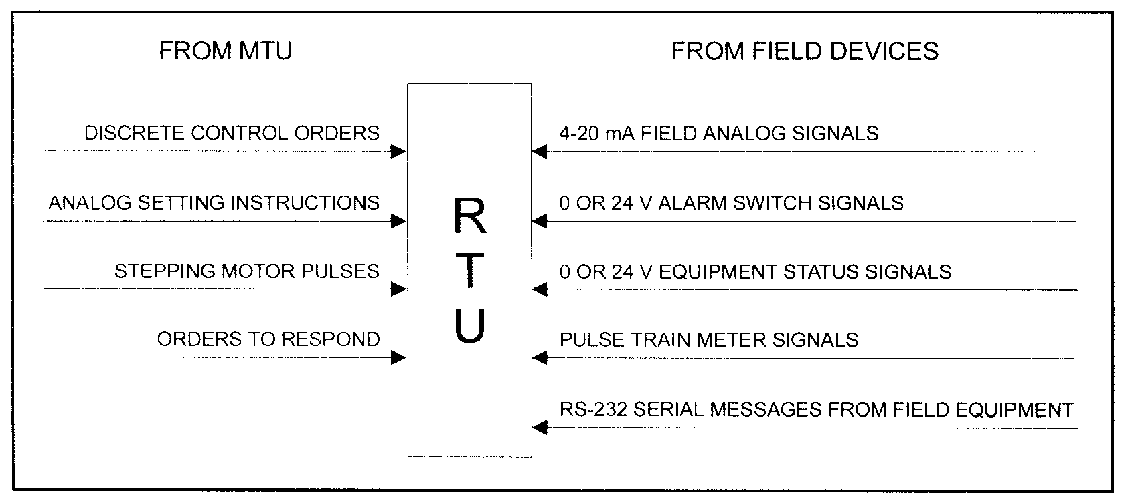

Slide 16

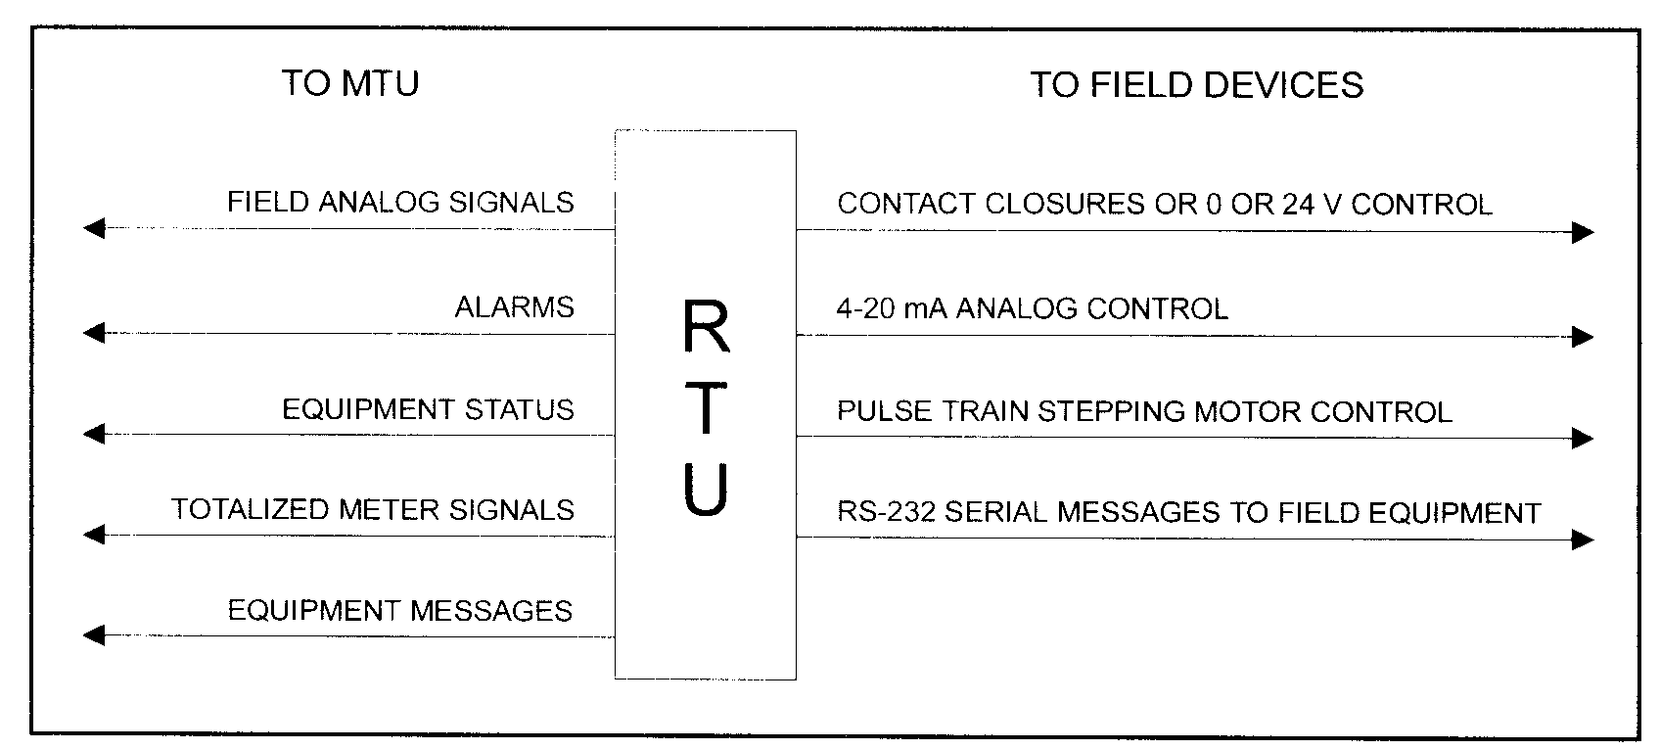

Slide 17
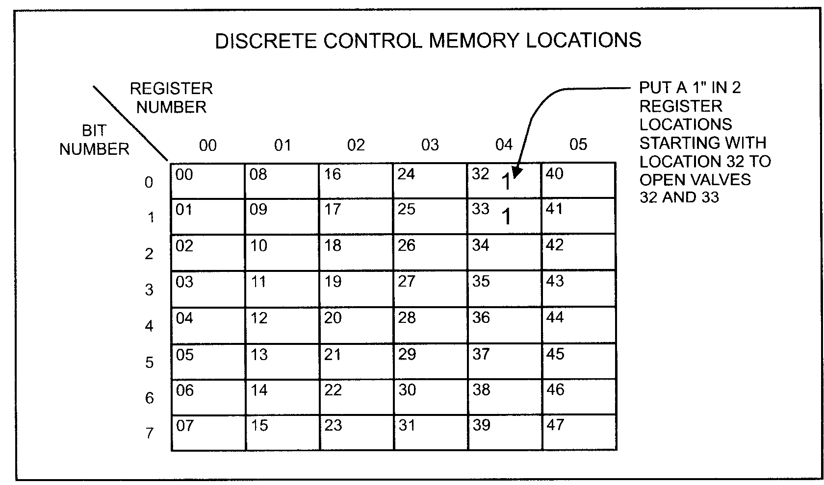
Discrete control
Each register can control eight discrete devices.
Valve close – 0
Valve open - 1

Slide 18
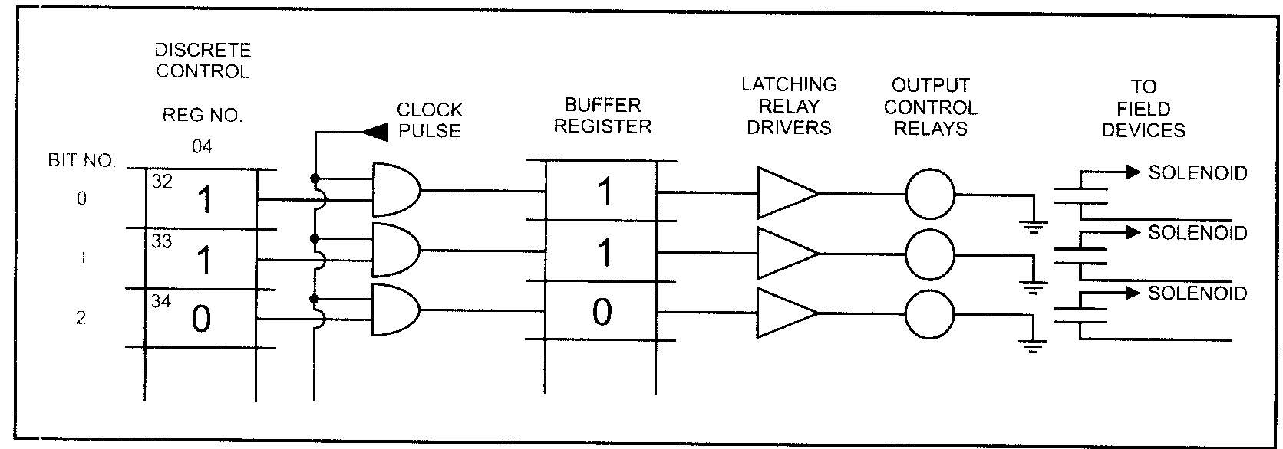

Slide 19
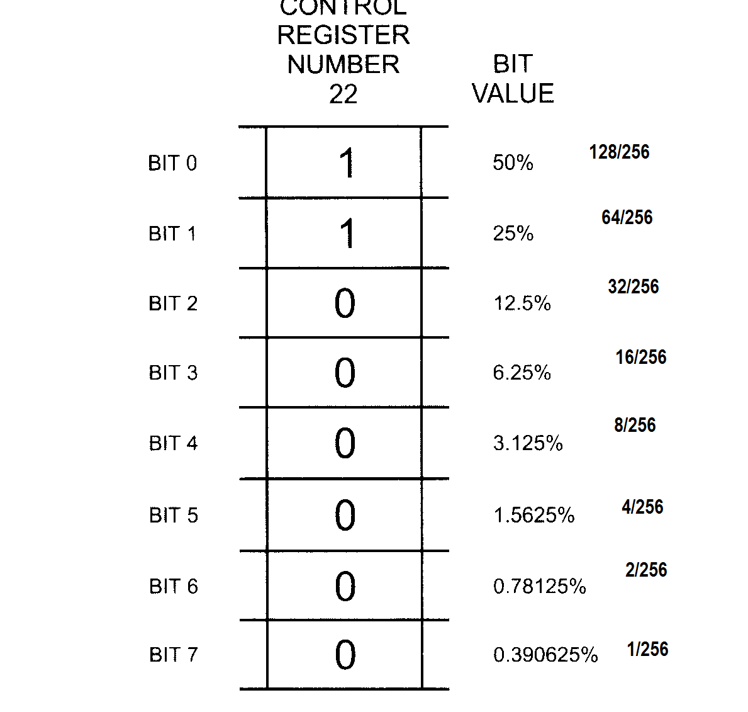
Analog Control

Slide 20
Register has been set 11000000 – 75%
50% open – 10000000
100% open – 11111111
60% - 11011001

Slide 21
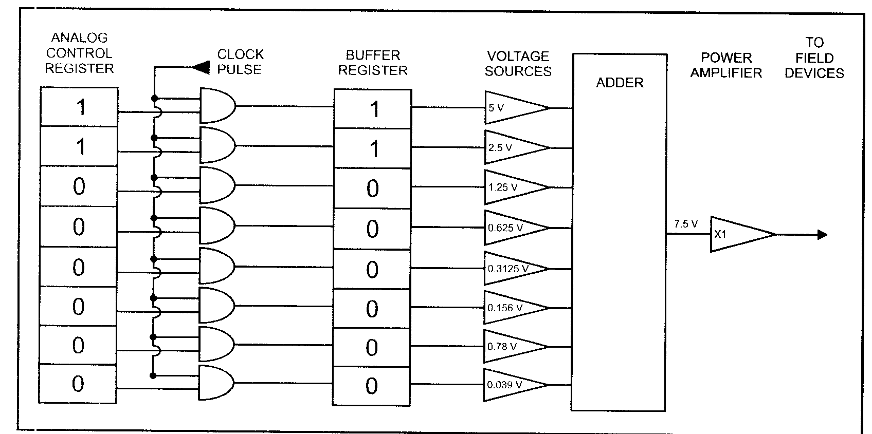


Slide 22
Communication Network
It is defined as a link between RTU in the field to MTU in the central location.
The bidirectional wired or wireless communication channel is used for networking purposes.
Various other communication mediums like fiber optic cables, twisted pair cables, etc. are also used.

Slide 23
SCADA Applications
Electric Power Generation, Transmission, and Distribution
Manufacturing Units
Mass transit and Railway Traction
Water, Waste Water Utilities and Sewage
Buildings, Facilities, and Environments
Water Security: The Role of the SCADA System
Thermal Power Plants

Slide 24
SCADA software
SCADA software can be divided into two types, proprietary or open.
1) Honeywell --- Experion HS 2) Trihedral --- VTScada 3) IDS --- HIGH-LEIT SCADA 4) Ecava --- IntegraXor ( IGX) 5) Copa --- Data zenOn 6) Afcon --- P-CIM 7) Ordinal --- MESbox SCADA 8) Yokogawa --- Fast/Tools 9) Siemens --- Simatic WinCC 10) TA-Engineering Products --- Aimax

Slide 25
Key features of SCADA software are:
User interface
Graphics displays
Alarms
Trends
RTU (and PLC) interface • Scalability
Access to data
Database
Networking
Fault tolerance and redundancy
Client/server distributed processing

